Slide 1
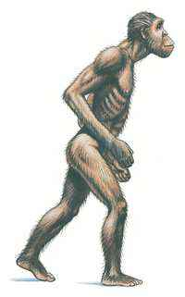
Is Jeff human?
Meet Jeff.
What are your impressions of him?
What is he?
With a partner make a table and list the similarities and differences between Jeff and modern humans.
Consider:
Appearance
Diet
Culture

Slide 2
Hominids vs. Humans
Hominids | Similarities | Humans
Have to forage for food | Walk upright | Able to easily obtain food
Hand to mouth existence |  | Stores food
Complete the Venn diagram: consider diet, culture as well as appearance

Slide 3
Matching Exercise
Prehistory
Hominids
Anthropologist
Paleontologist
Artifact
Radiocarbon dating
Nomads
Culture
Technology
Period of history before people developed writing.
Humanlike creatures.
A person who studies hominids.
Studies fossil remains to determine the characteristics of different prehistoric periods.
Any objects shaped by human hands.
A technique for determining age of remains.
People who move constantly in search for food.
A way of life.
The skills and useful knowledge available to people for collected material and making objects necessary for survival.

Slide 4
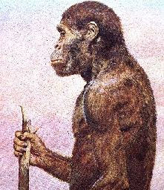
Early Hominids
Human like animals that walked upright were known as hominids. It is believed that the earliest hominids lived around 4.4 million years ago in the humid forests of eastern and southern Africa.
These animals, known as Australopithecus are believed to have been around three to five feet tall, and probably fed on leaves, fruits, and the remains of dead animals. There is no evidence that Australopithecus made their own tools. There is however strong evidence that they used sticks, and bones to help them dig, and defend themselves.

Slide 5
Origins of early humans
Scientists are not sure whether a direct relationship connected Australopithecus and human beings.
They also don’t know when hominids became truly human.
The word “homo” means human in Latin
Homo-hablis = a person with ability (hominid)
Homo-erectus = person who walks upright (hominid)
Homo-sapien = person who thinks (early human)
All people today belong to homo-sapiens

Slide 6
